Slide 1


The Neotia University
West Bengal | Bachelor of Computer Applications (BCA) — Academic Year 2025–2027
Project :-
AI Resume Screening & Candidate Ranking System
Presented BY:-
Group Name: A
Team Members:-
Debasish Jana — UID: TNU2023069100063
Rahul khan — UID: TNU2023069100047
Soumili Mandal — UID: TNU2023069200034

Slide 2
Agenda
1. Problem & Objectives
2. System Architecture
3. Technology Stack
4. Implementation
Linear pipeline from PDFs to ranked output.
Streamlit, PyPDF2, pandas, scikit-learn.
Key functions and workflow.
Why manual screening fails at scale.
5. I/O Example
6. Advantages, Limits & Future
Sample job description, resumes, and ranked results.
Benefits, trade-offs, and next steps.

Slide 3


Problem: Why Manual Screening Breaks
Manual resume screening doesn't scale with applicant volume. Recruiters receive far more resumes than can be read carefully for every role, making timely review unrealistic.
High Volume
Slow & Inconsistent
Large applicant pools prevent detailed manual review for each candidate.
Human review is time-consuming and yields variable judgments across reviewers.
Bias Risk
No Quick Ranking
Unconscious bias and fatigue can distort screening outcomes.
There is no fast, repeatable method to rank candidates against a specific job description.

Slide 4

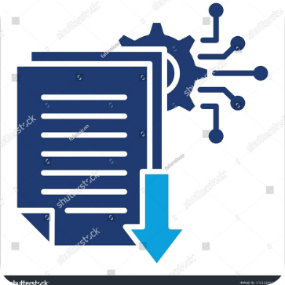
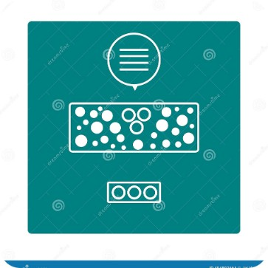
Objectives
Design an automated screening system that accepts a free-text job description and multiple PDF resumes, extracts text, computes similarity scores, and returns a ranked candidate table.
Resume Upload
Text Extraction
Scoring & Ranking
Allow multiple candidate resumes in PDF format to be uploaded via the UI.
Automatically extract readable text from each uploaded resume (PDF text layer).
Score resumes against the job description using TF-IDF + cosine similarity and display ranked results.

Slide 5
System Architecture & Methodology
The system is a linear pipeline: input → extraction → vectorization → similarity → ranked output. Each stage is modular and lightweight, enabling local execution without paid external APIs.
Step 1 — Input
Step 2 — Extraction
Step 3 — Vectorization
PDF resumes + free-text job description (user input).
Extract text from PDFs using PyPDF2; concatenate pages into a single string.
Fit a shared TF-IDF vocabulary (scikit-learn TfidfVectorizer) on documents.
Step 4 — Similarity
Step 5 — Output
Compute cosine similarity between job description vector and each resume vector.
Return sorted results table of candidates from best match to weakest.

Slide 6
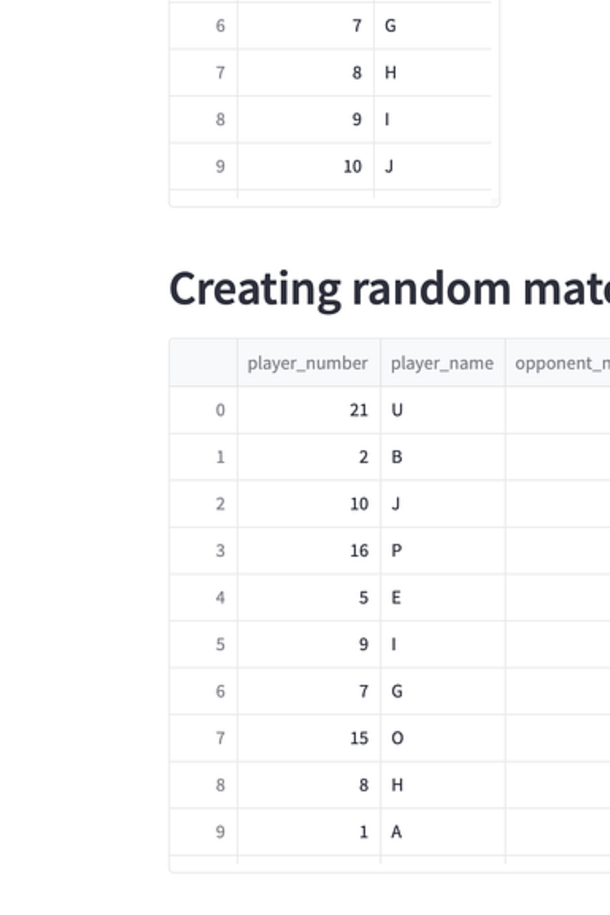




Technology Stack
Streamlit
PyPDF2
Web UI for job description input, PDF uploader, and interactive results table.
Extracts text content from each uploaded PDF resume, page by page.
pandas
scikit-learn
Builds and sorts the ranked results DataFrame for presentation and export.
TF-IDF vectorization and cosine similarity scoring (TfidfVectorizer + cosine_similarity).
Language: Python 3. Implementation uses purely open-source Python libraries for a lightweight, reproducible pipeline.

Slide 7
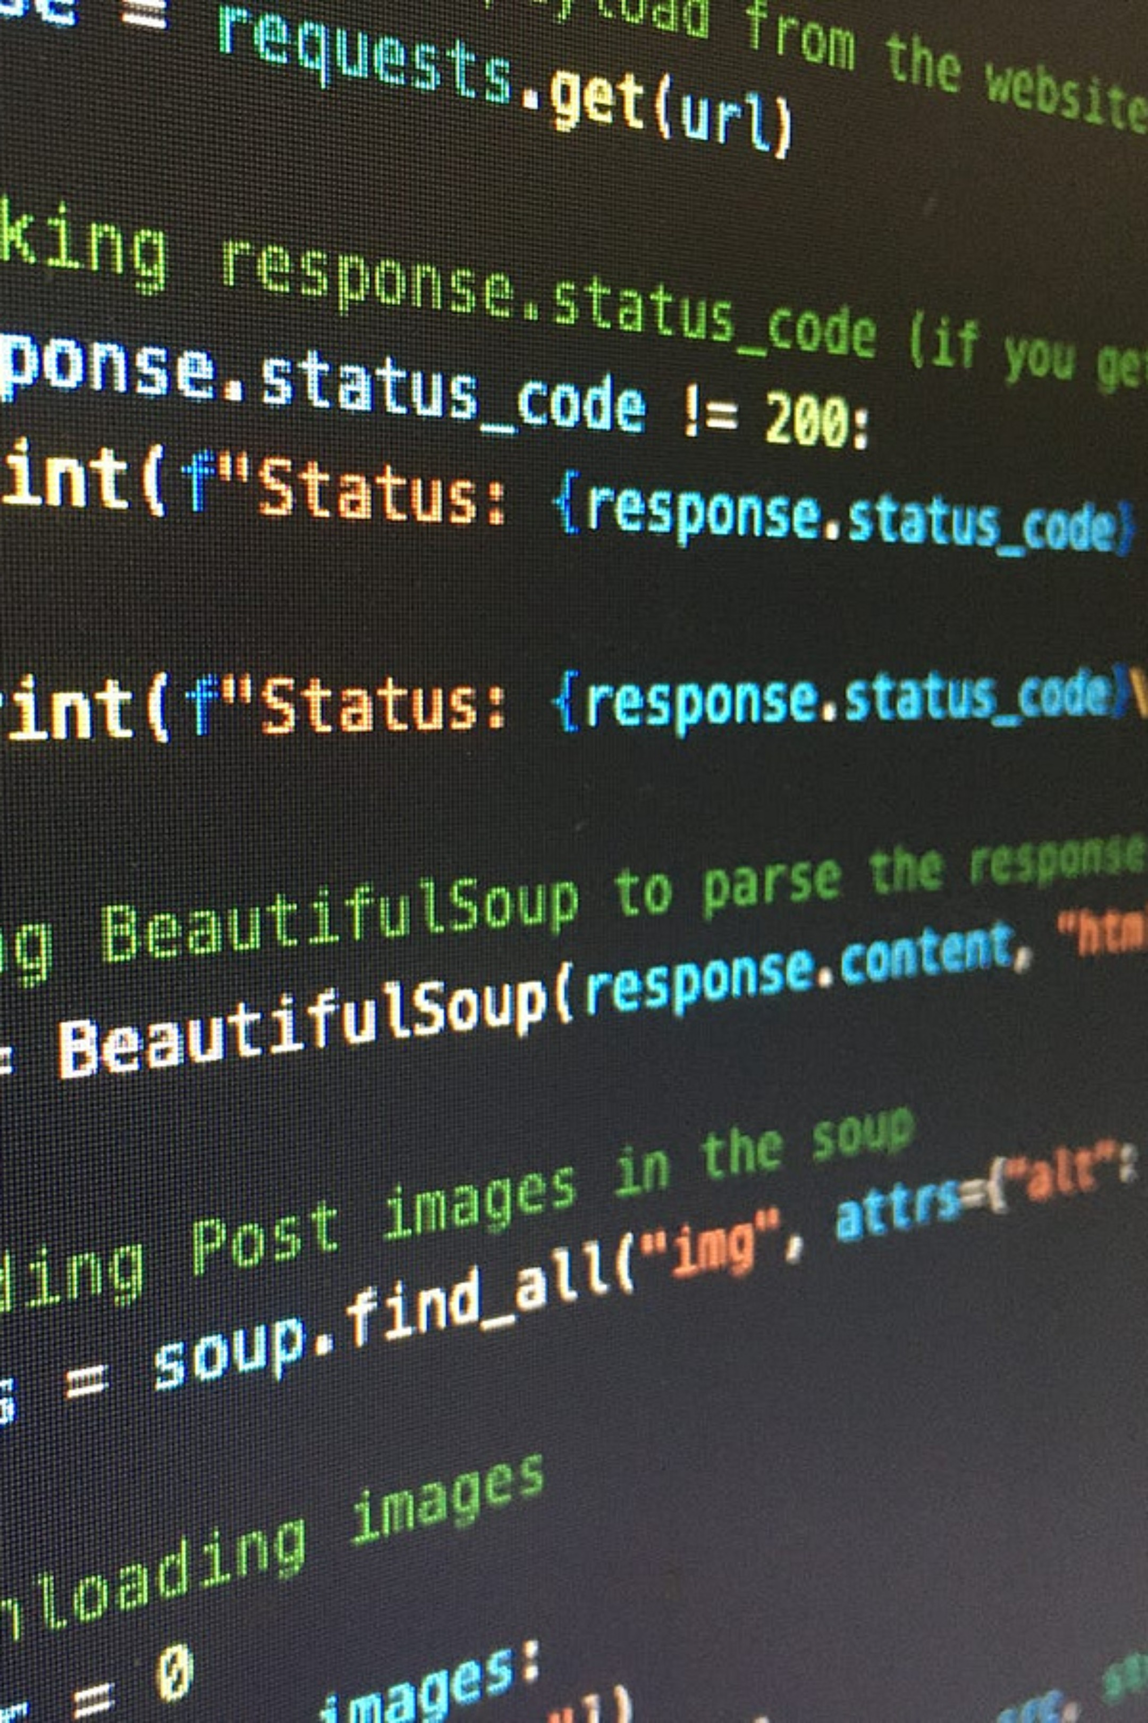
Implementation — Core Functions
Key code is concise and focused on reproducible steps that mirror the architecture.
extract_text_from_pdf(file)
rank_resumes(job_description, resumes)
Reads every page using PdfReader, concatenates extracted text into one string for each resume.
Constructs documents = [job_description] + resumes, fits TfidfVectorizer, computes vectors, then returns cosine_similarity([jd_vec], resume_vecs).flatten().

Slide 8
Input / Output Example (Live Demo Data)
Job Description: “Looking for a Python Developer with strong experience in data analysis and machine learning — skilled in Python, pandas, scikit-learn, SQL, Flask/Django REST APIs, Git.”
Rank | Resume | Similarity Score
1 | Resume_Aisha_Khan.pdf — Python, pandas, scikit-learn, Flask, SQL | 0.5660
2 | Resume_Karan_Verma.pdf — Data scientist, Python, Flask, SQL, Git | 0.4682
3 | Resume_Rohan_Das.pdf — Frontend: HTML/CSS/JS/React only | 0.2907
4 | Resume_Meera_Iyer.pdf — Java/Spring Boot, basic SQL | 0.1959
This ranked output is computed directly by the described rank_resumes function and demonstrates relative match strength for shortlisting.

Slide 9

Advantages
Removes the need to manually read every resume for an initial shortlist.
Delivers consistent, repeatable rankings for the same inputs.
Lightweight implementation that requires no paid external API.
Simple interactive UI — accessible to non-developers via Streamlit.
Limitations
TF‑IDF captures vocabulary overlap, not deep semantic meaning — synonyms may score lower.
Extraction quality depends on PDF text layers; scanned/image-only resumes will not be read reliably.
Screening aid only — the system does not verify claims or replace human hiring judgment.

Slide 10
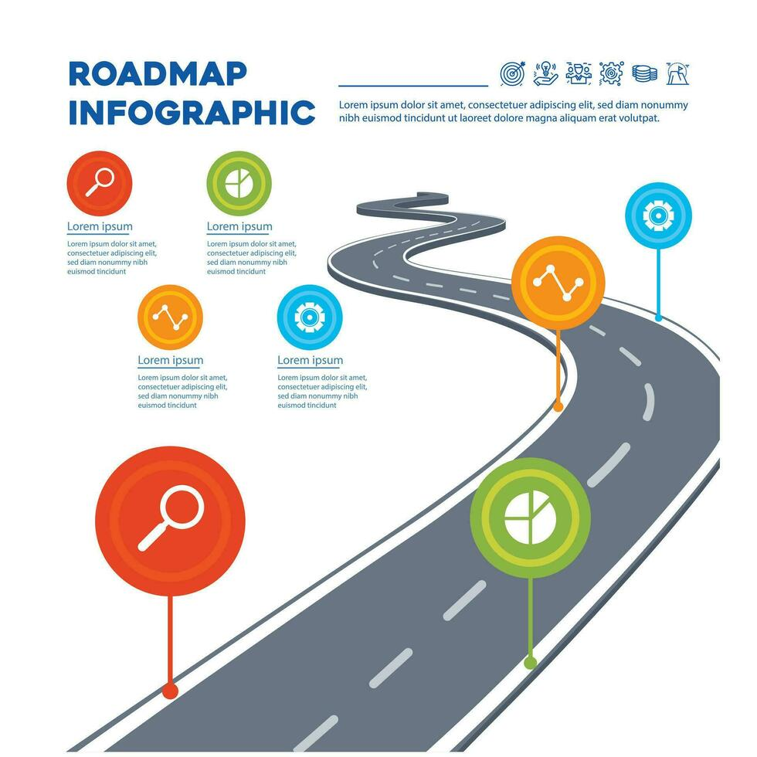
Future Scope — Roadmap
1
01 — Semantic Embeddings
Replace TF‑IDF with sentence-transformers to capture meaning, not just keyword overlap.
2
02 — Backend API
Add a Flask or FastAPI backend so ranking can be invoked outside the Streamlit UI and integrated into ATS systems.
3
03 — Auth & Persistence
Add authentication and persistent storage for recruiters to save and revisit past sessions.
4
04 — Explainability
Highlight specific matched keywords/skills behind each resume score to aid human review.

Slide 11

Conclusion & Next Steps
This project demonstrates a practical end-to-end application of text vectorization and similarity scoring for hiring: TF‑IDF + cosine similarity provides an automated, consistent first-pass ranking of candidates via a Streamlit interface. It is a simple, extensible foundation that can evolve to semantic embeddings, backend APIs, and explainability to better assist recruiters.

Slide 12

Thank You!

